Slide 1


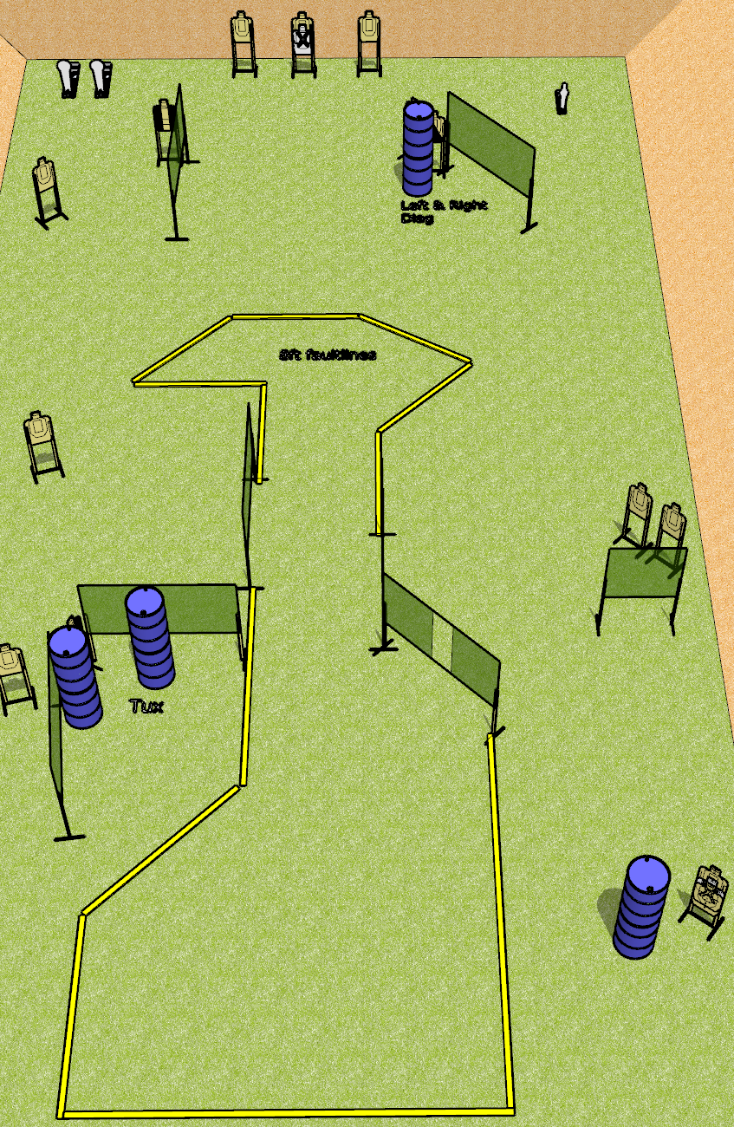
 | Dothan Gun Club – USPSA Match Long Run Course Designer : Drew Coleman
Round Count 31 rounds 14 USPSA 2 colt, 1 mini
Equipment List 14 wall feet 2 tux, 1 left diag, 1 right diag 12 paper (10 + 2 NS)
Stacked
w/ NS

Slide 2
Long Run
Written Stage Briefing
Long Run is a 31 round, 155 point, Comstock course of fire. There are 14 USPSA targets and 3 steel. The best 2 hits on cardboard will score, and steel must fall to score.
Handgun start position is anywhere inside the shooting area, wrists below belt. Handgun is loaded and holstered.
PCC start position is anywhere inside the shooting area, stock on belt. Loaded carbine is held with both hands, safety on.
On start signal, engage targets as they become available from within the shooting area.

